Slide 1
Learning Graph Neural Networks with Deep Graph Library
Minjie Wang & Lingfan Yu
with DGL Team
New York University, NYU Shanghai, AWS, AWS Shanghai AI Lab
GTC 2019 Instructor-led training (L9134)
http://dgl.ai

Slide 2
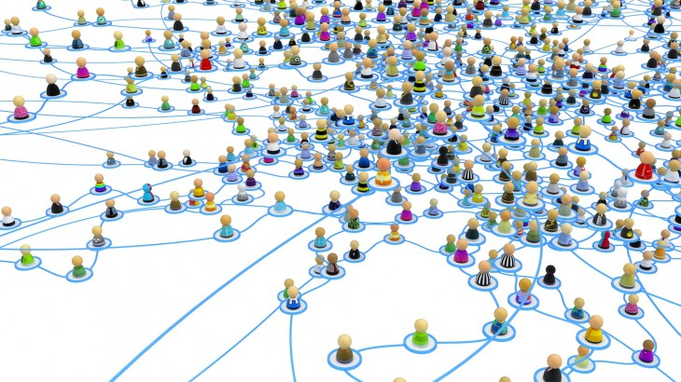
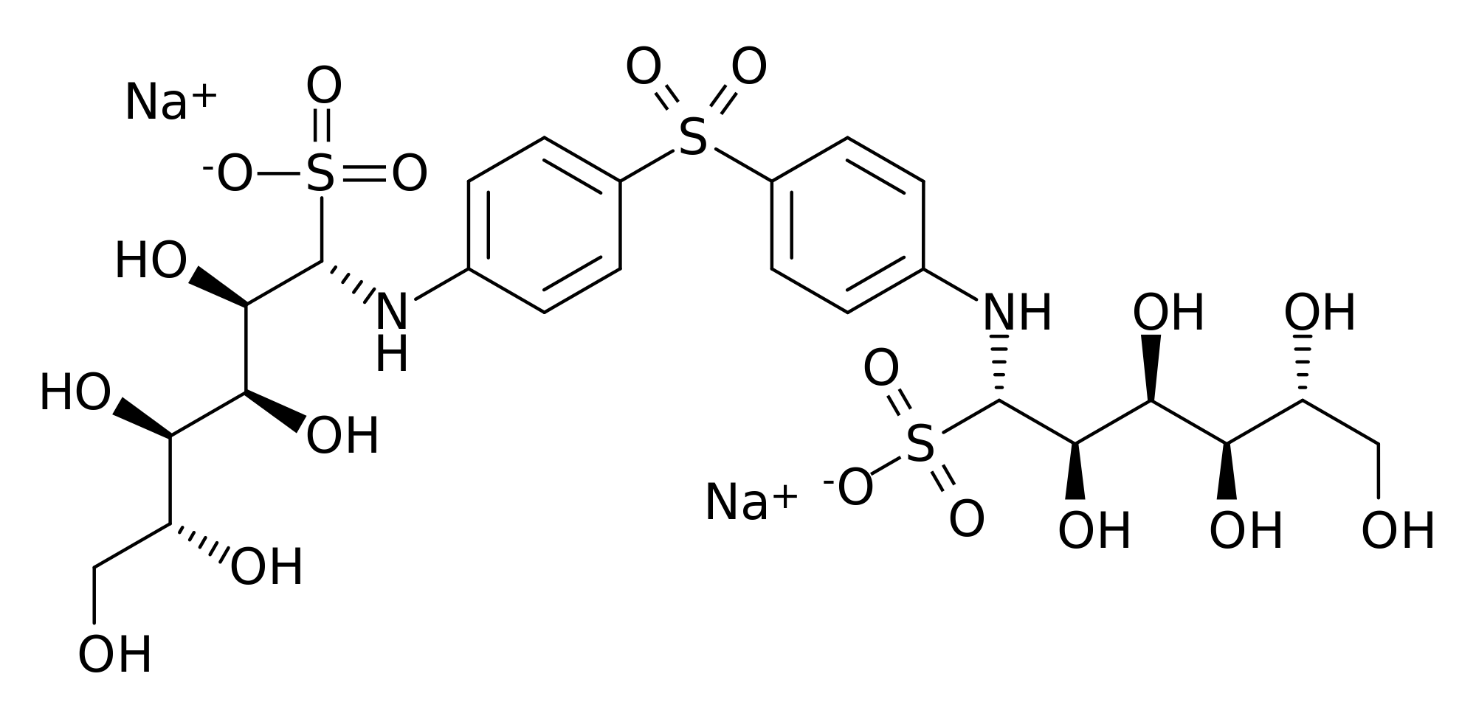
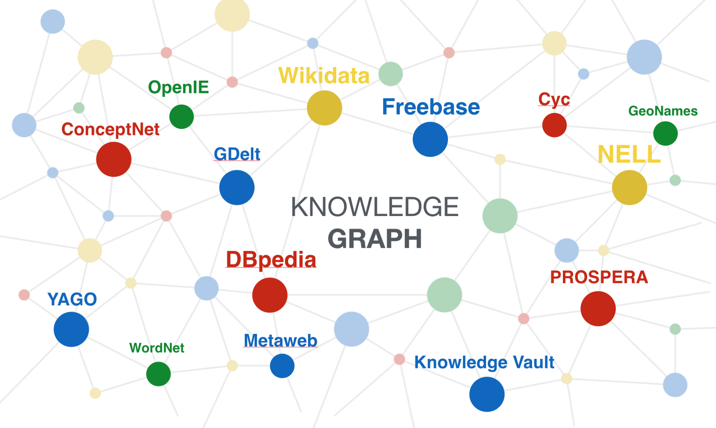
Graph data are everywhere
Social network
Protein/Molecule structure
Knowledge graph

Slide 3
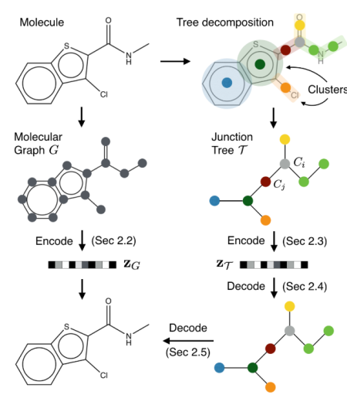
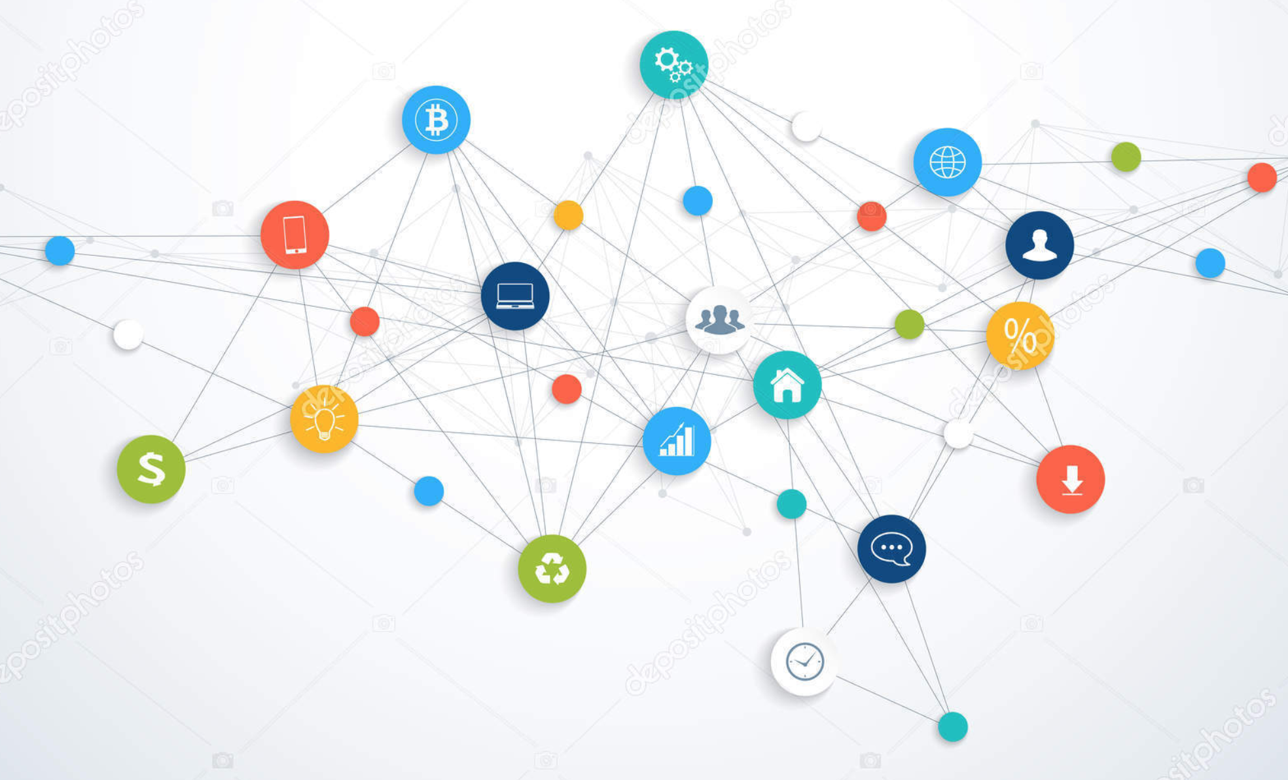
Many ML tasks learn from graphs
Community detection
Find new molecules
Knowledge base completion
Social Network
[Chen et al. arxiv’18]
Molecule Graph
[Jin et al. ICML’18]
Knowledge Base
[Schlichtkrull et al. arxiv’17]

Slide 4
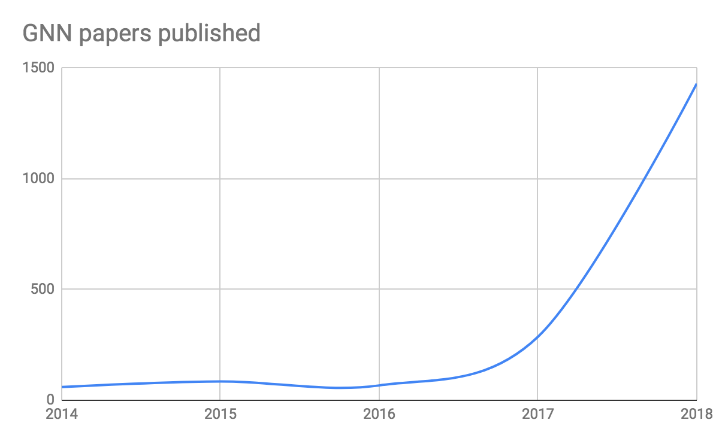
Deep learning + Graph => GNN
Graph neural network (GNN) is emerging as an important class of DL models.

Slide 5
What you’ll learn from this tutorial
Introduction (30 mins):
What is GNN?
Why a new tool for writing GNNs?
Hands-on Tutorial (1 hr 30 mins):
Write a popular GNN: Graph Convolution Network [ICLR’17]
Use GCN to to perform community detection

Slide 6
What is GNN?
CNN: learn embedding of an image
cat
CNN
Classifier
dog

Slide 7
When deep learning meets graph
Graph Neural Network (GNN): learn embedding on graphs
GNN
Classifier

Slide 8
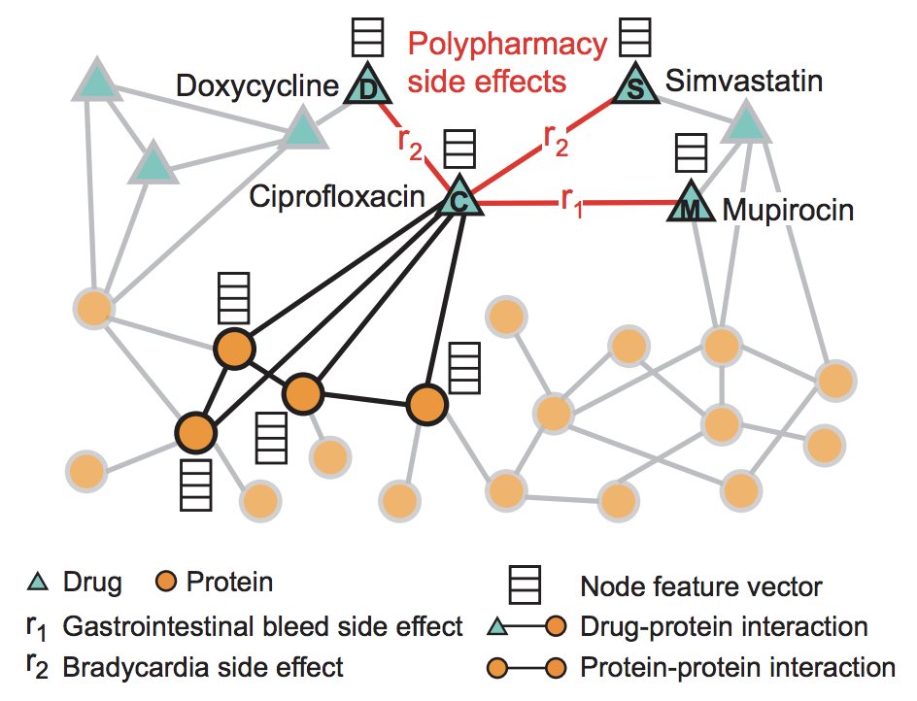
GNN in computational biology
Protein-Protein Interaction (PPI) Prediction
[Zitnik et al. ISMG’18 tutorial]
Drug repurposing
[Zitnik et al. Bioinformatics’18]

Slide 9
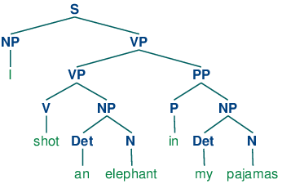
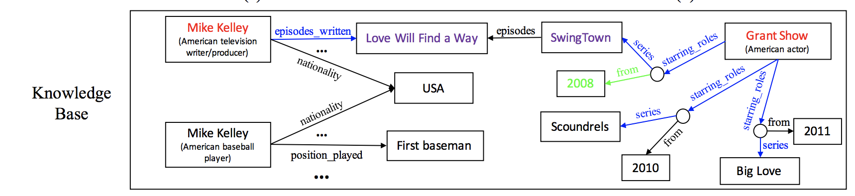
GNN in Natural Language Processing
Sentiment analysis based
on sentence parse tree
[Tai et al. ACL’15]
Knowledge Graph for QA
[Mo et al. ACL’17]

Slide 10
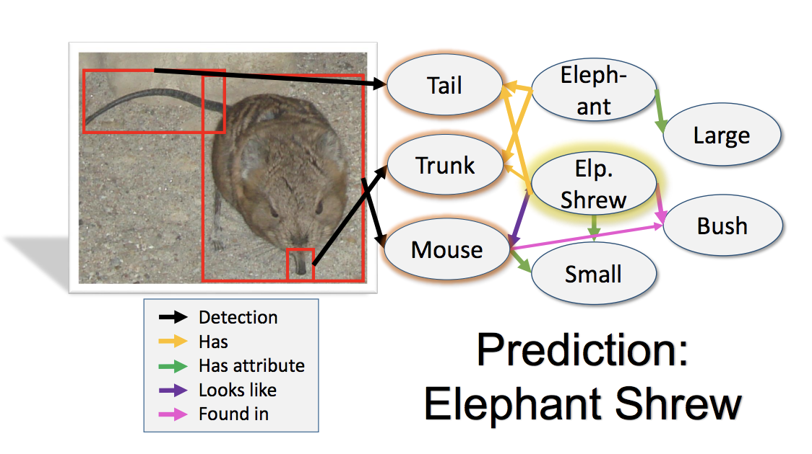
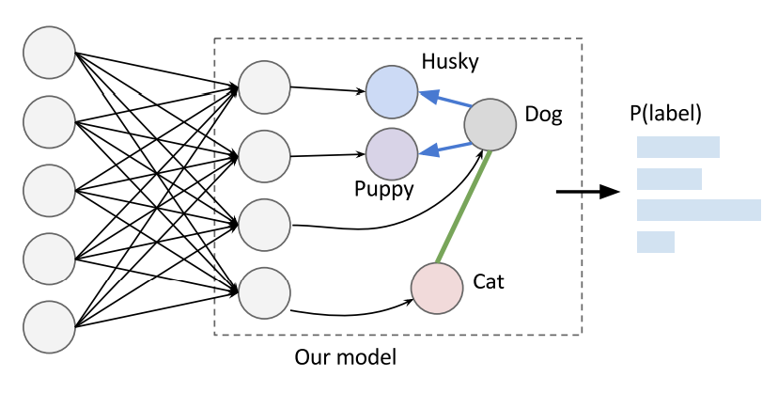
GNN in Computer Vision
Knowledge Graph for
Image Classification
[Kenneth et al. CVPR’17]
Label Graph for
Image Classification
[Jia et al. ECCV’14]

Slide 11
Existing tools do not support GNNs well
Writing GNNs is hard in TensorFlow/Pytorch/MXNet.
(Our implementation) caused OOM … which is the reason for the lack of results on Pubmed.
-- from the authors of Graph Attention Network [ICLR’18]

Slide 12
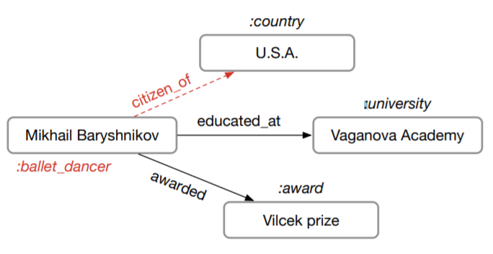
Existing implementations are often slow
Sentence Parse Tree
[Tai et al. ACL’15]
Molecule Graph
[Jin et al. ICML’18]
Knowledge Base
[Schlichtkrull et al. arxiv’17]
Training speed of one popular PyTorch version is only 23 trees/s
Author’s code in PyTorch: 8.25 graphs/s
Cannot run on GPU
due to OOM

Slide 13

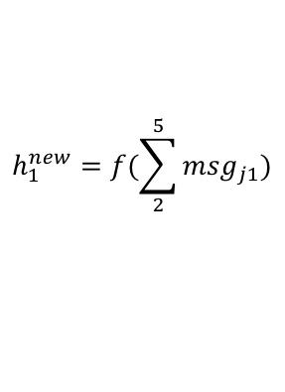
Why is programming GNN hard?
GNN is based on message passing
Tensorflow/Pytorch/MXNet provides tensor programming
h₅
h₂
v₅
v₂
$${msg}_{51}^{}=h_{5}$$
v₁
$$h_{1}^{new}=f(\sum_{2}^{5}{{msg}_{j1}})$$
v₃
v₄
h₄
h₃
How tensors are transformed
On edge: how messages are calculated
On node: how messages are aggregated and consumed

Slide 14
Our System: Deep Graph Library (DGL)
GNN Models
DGL
Message Passing
Graph Sampling
Batched Graphs
…
Pytorch
MXNet
more is coming …
Compilers (TVM (Neo), ONNX)
GPU, FPGA, IP core, Arm …

Slide 15
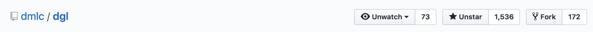
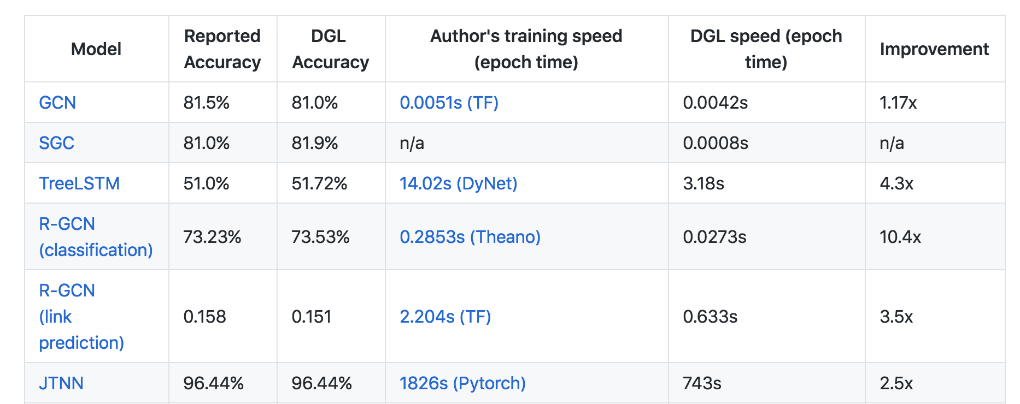
DGL has open-sourced

Slide 16
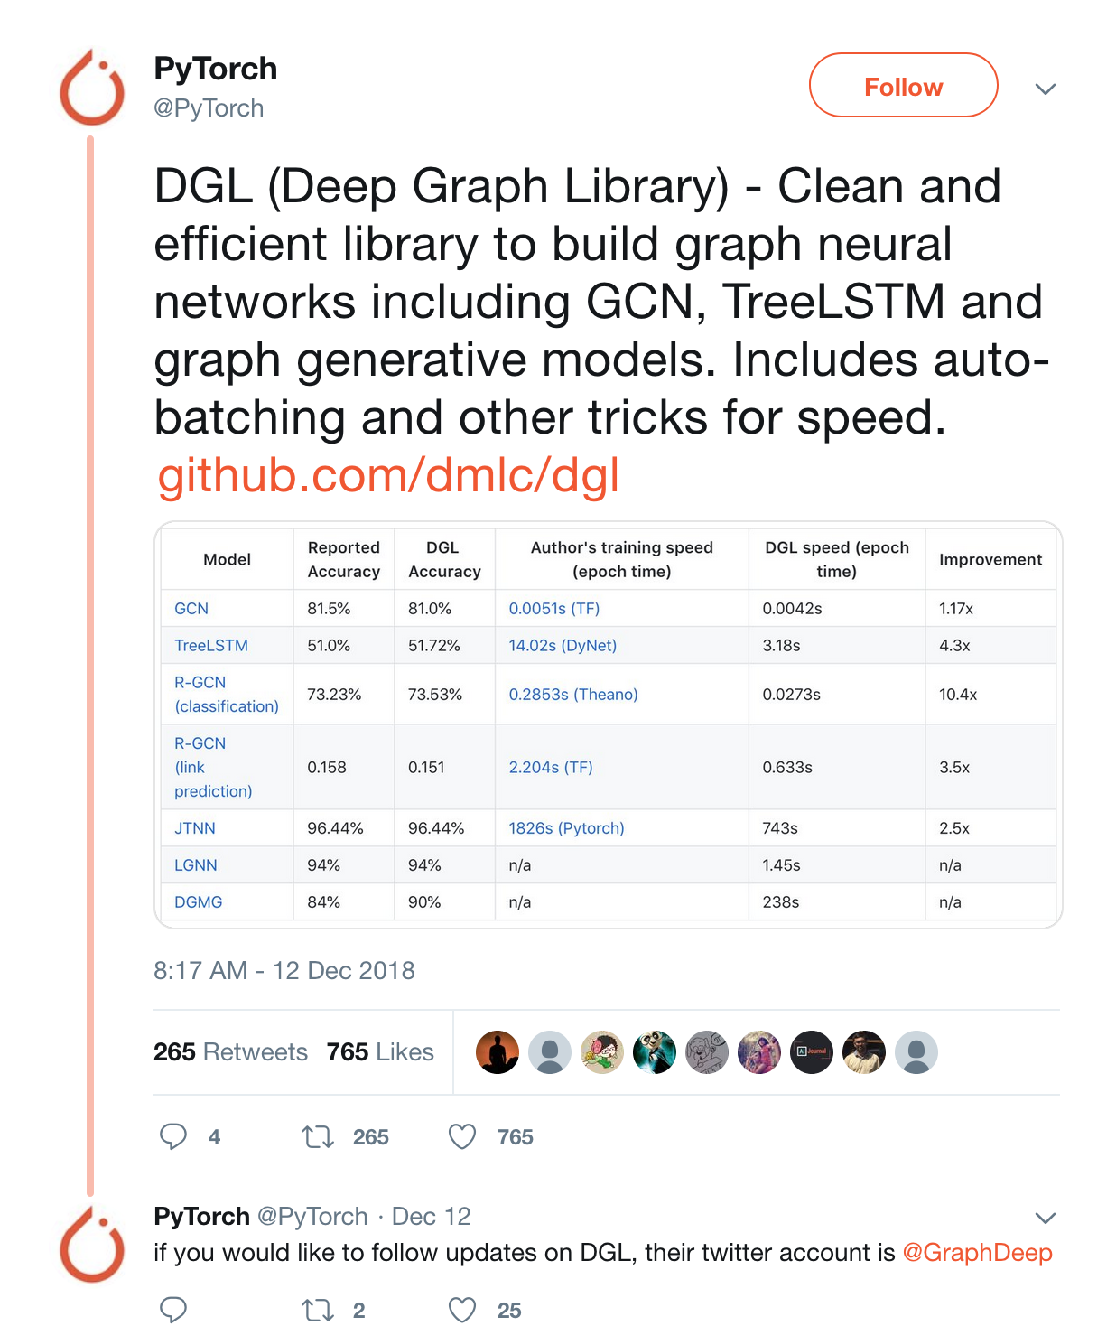
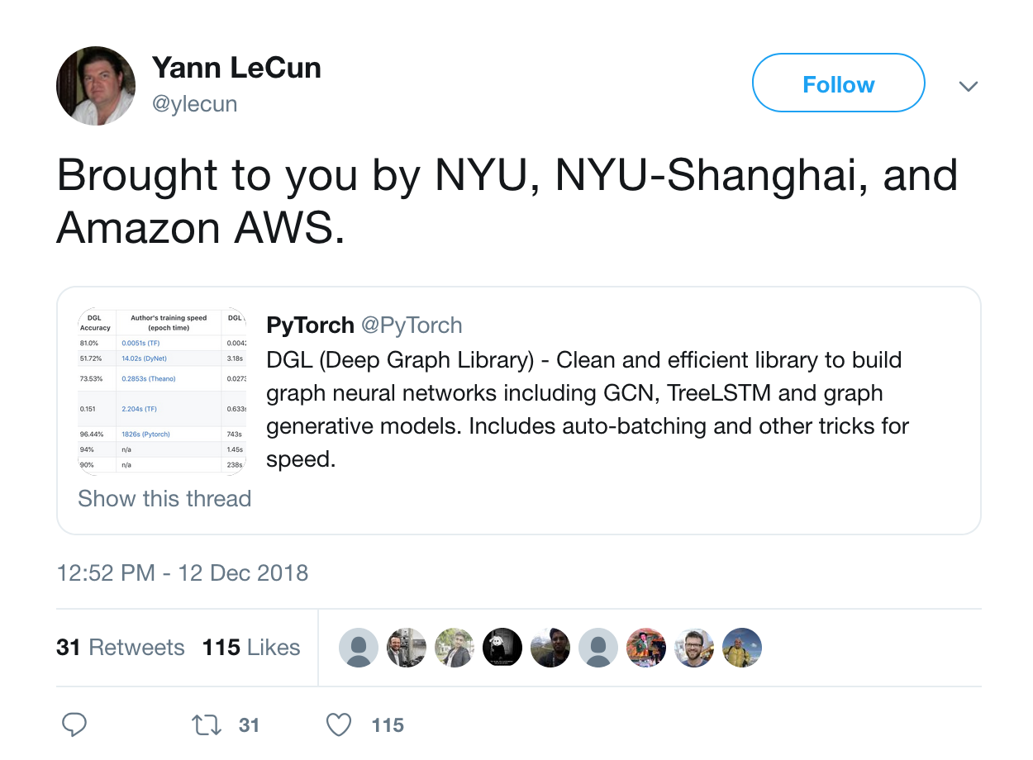
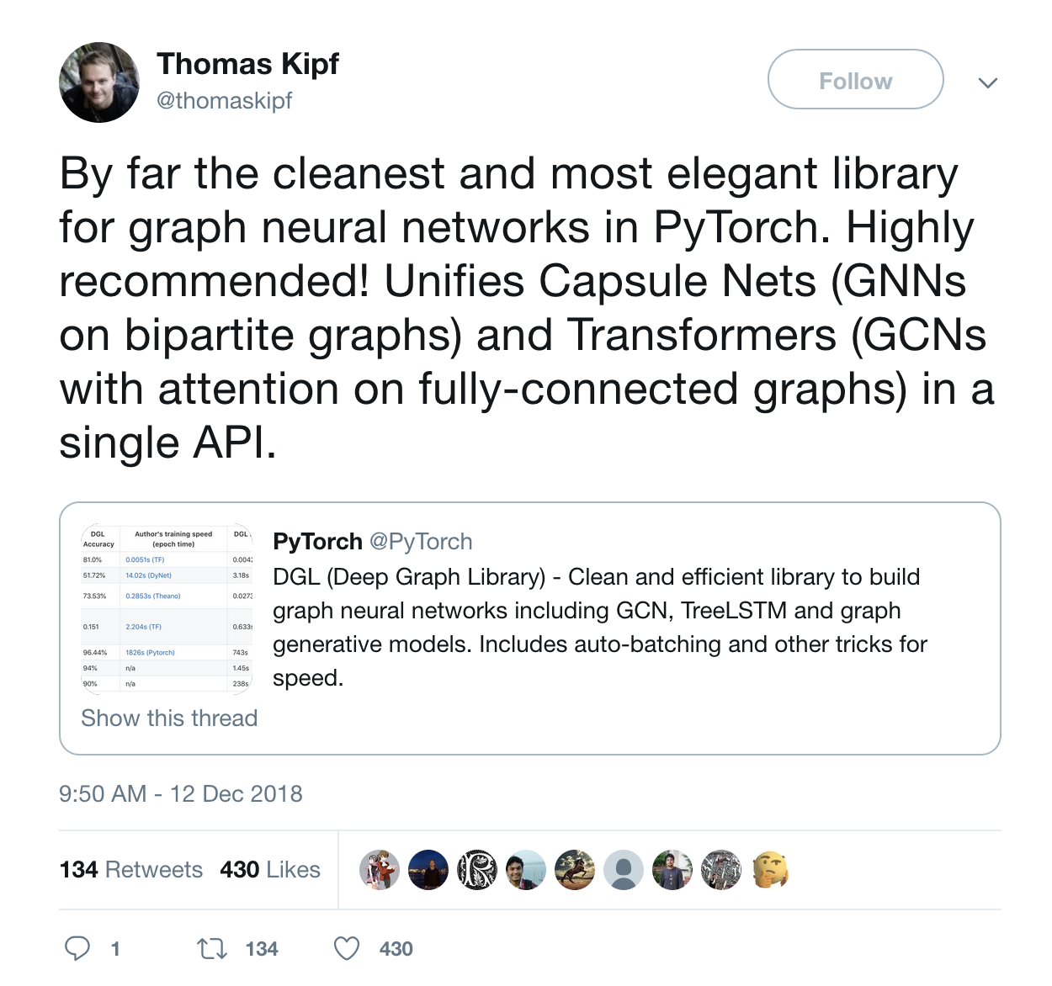

Slide 17
DGL’s offers
12 off-the-shelf most popular GNN models (w/ detailed tutorials)
A central repo for 9 popular GNN datasets (cora, pubmed, …)
Easy developing for advanced GNNs:
Sampling for Large graphs
PinSAGE [WWW’18], [Jianfei et al., ICML’18], FastGCN [ICLR’18], …
Dynamic graphs
JTNN [ICML’18], DGMG [CVPR’18], …
Batching of Multiple graphs
TreeLSTM [ACL’15], GAT [ICLR’18], …

Slide 18
Tutorial outline
Basics.ipynb
Contruct a graph for community detection
MessagePassing.ipynb
Try some basic message passing
GCN.ipynb
Implement Graph Convolutional Network
Speedup.ipynb
Speed up tricks in DGL
BatchGraph.ipynb
(Advanced) Batch execution of multiple graphs, and perform efficient read-out on batch of graphs

Slide 20
DGL’s Message Passing Model
Message phase
V₁
E₁₃
V₃
M₁₃
message_func( , , ) =
V₂
E₂₃
V₃
M₂₃
V₁
1
E₁₃
3
V₃
E₂₃
2
V₂

Slide 21
DGL’s Message Passing Model
Reduce phase
M₁₃
reduce_func( ) =
M₃
M₂₃
V₁
1
E₁₃
3
V₃
E₂₃
2
M₁₃
V₂
M₂₃

Slide 22
DGL’s Message Passing Model
Apply phase
apply_func( , ) =
V₃
M₃
V₃
V₁
1
E₁₃
3
V₃
E₂₃
2
V₂

Slide 23
DGL’s Message Passing API
Define computations over batched of nodes / edges
Send(u, v, message_func)
Recv(v, reduce_func, apply_func)
A batch of edges
Source
Node
Destination
Node
<message>: edges
<apply>: nodes
edges.src
edges.data
edges.dst
<reduce>: nodes
A batch of source nodes
*Mailbox will be emptied after recv call triggers the node UDF.
Mailbox*

Slide 24
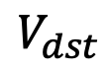
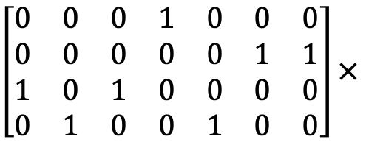
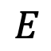
Fuse message passing
If reduce function is sum
Fuse reduce for all nodes into one sparse kernel
M₁₃
M₁₃
$$E$$
M₁₄
M₁₄
M₁
$\left[\begin{matrix}0 & 0 & 0 & 1 & 0 & 0 & 0 \\ 0 & 0 & 0 & 0 & 0 & 1 & 1 \\ 1 & 0 & 1 & 0 & 0 & 0 & 0 \\ 0 & 1 & 0 & 0 & 1 & 0 & 0\end{matrix}\right]×$
M₂₃
M₂₃
M₂
$$V_{dst}$$
M₂₁
M₂₁
M₃
M₃₄
M₃₄
M₄
M₃₂
M₃₂
M₄₂
M₄₂

Slide 25
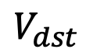
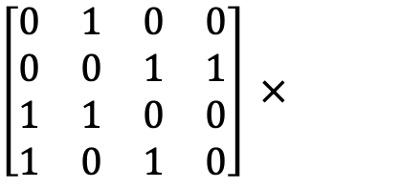
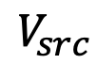
Fuse message passing
If message function copies source node data and reduce function is sum
Fuse message and reduce phase into one sparse kernel
Avoid materializing messages
$$V_{src}$$
V₁
M₁
$\left[\begin{matrix}0 & 1 & 0 & 0 \\ 0 & 0 & 1 & 1 \\ 1 & 1 & 0 & 0 \\ 1 & 0 & 1 & 0\end{matrix}\right] ×$
V₁
V₂
M₂
V₂
$$V_{dst}$$
V₃
M₃
V₃
V₄
M₄
V₄

Slide 26
Batch Multiple Graphs
Concatenate multiple graphs to be one graph with many disjoint connected components
Graph 1
[ ]
Graph 2
=
batch
Graph 1
Graph 2

Slide 27
Resources
DGL website: http://dgl.ai/
DGL GitHub Repository: https://github.com/dmlc/dgl
DGL discuss forum: https://discuss.dgl.ai/
Please try it! And welcome contributions!!

Slide 28

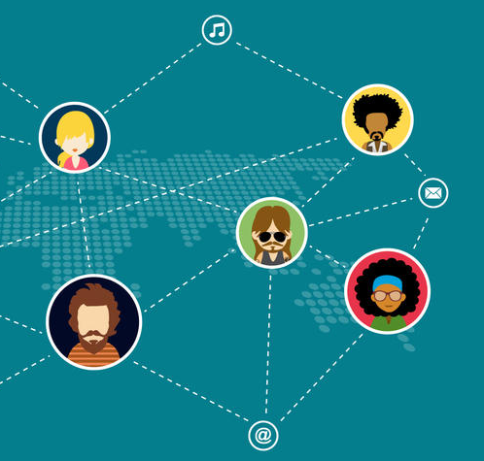
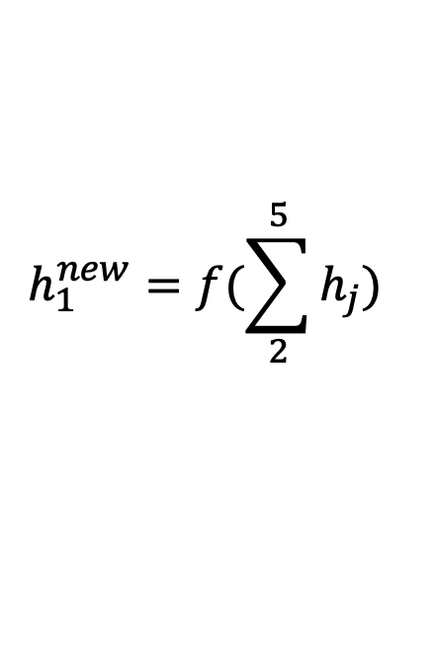
Representation Learning
Generating representation of nodes, which can later be used to predict node properties.
h₅
h₂
v₅
v₂
v₁
$$h_{1}^{new}=f(\sum_{2}^{5}{h_{j}})$$
v₃
v₄
h₄
h₃
Notes:
A new class of neural network has emerged and gained popularity recently
Incorporate relational information

Slide 29
Comparison with other systems
 | GraphNets | NGra | Euler | DGL
Active set | ❌ | ❌ | ❌ | ✅
Arbitrary reduce | ✅ | ❌ | ✅ | ✅
Auto-batching of reduce | ❌ | ❌ | ❌ | ✅
Batch multiple graphs | ✅ | ❌ | ❌ | ✅
Kernel fusion | ❌ | ❌ | ❌ | ✅

